Slide 1


Team Details
  Team name: Ceylon InnovAI (Maniesha Abeysekera, Ashen Weerasinghe)
  Team leader name: Maniesha Abeysekera
  Problem Statement: Manufacturing: Intelligent Operations & Industrial Efficiency

Slide 2

Brief about the idea
SiteGuard AI turns a phone photo and a voice note into a verified, auditable safety record.
On factory floors, warehouses and industrial sites, hazards such as blocked walkways, open edges and missing PPE are still logged on paper — inconsistent between inspectors, hard to track to a fix, and almost never verified once "fixed".
1
Capture
A reviewer photographs the hazard and records a voice note.
2
Gemini proposes
One multimodal Gemini call returns a structured finding with a calibrated confidence score.
Real evidence: stock and cardboard spilling into a warehouse walkway (Aisle 3).
3
People decide
A human confirms, assigns and closes every record; Gemini verifies the fix against the original evidence.
Theme: Manufacturing — Intelligent Operations & Industrial Efficiency. Operational evidence becomes findings, actions and insights.

Slide 3
Opportunities
1
2
3
How is it different from existing ideas?
How will it solve the problem?
USP of the proposed solution
• Most safety tools are digital checklists, or vision models that output a verdict.
• SiteGuard reads photo + voice + context in one Gemini call, says "inconclusive" when evidence is weak, and verifies closure by comparing before/after evidence for that specific hazard.
• The AI never decides — a person approves every state change.
• Replaces paper binders with one consistent, structured finding per photo.
• Every hazard gets an owner, a due date and an escalation rule.
• An append-only audit trail links each decision to its evidence and reviewer.
• Site Insights shows managers hotspots, repeat hazards and overdue actions.
• Every hazard seen. Every fix verified.
• AI-verified closure with a human in the loop — not just detection.
• Numbers are computed, not generated: risk and insight counts come from deterministic Python.
• A new hazard class is a new prompt, not new infrastructure.

Slide 4
List of features offered by the solution
1
Multimodal capture
2
Structured AI finding
3
Calibrated confidence
4
Deterministic risk matrix
Photo, voice note, typed note, location and time — analysed together in one Gemini call.
Category, impact, suggested actions and owner team, enforced by a response schema.
Confidence score plus an explicit "inconclusive" when angle or lighting prevent a clear read.
Likelihood × severity scored in Python, so every risk level is defensible.
5
Actions & escalation
6
Audit trail & alerts
7
AI closure verification
8
Site Insights
Owner, priority, target date and escalation rule for every corrective action.
Append-only history and a notification feed built from it; HTML reports and CSV export.
Gemini compares new evidence with the original finding; the reviewer approves or rejects.
Gemini briefs managers on recurring hazards, hotspots, overdue teams and blind spots.

Slide 5
Process flow diagram
1
REVIEWER
2
GEMINI
3
REVIEWER
4
SYSTEM
Capture
Photo + voice note + location
Analyse
Structured finding + confidence
Review & confirm
Confirm, reject or edit
Risk & assign
Risk matrix, owner, due date
7
REVIEWER
6
GEMINI
5
REVIEWER
Approve closure
Record closed + report
Verify
Compare against original finding
Follow-up
New evidence on a later visit
★
Site Insights (manager) Python computes the register digest → Gemini interprets it → focus areas, repeat hazards, overdue teams and blind spots.
Every state change in steps 1–7 is written to the append-only audit trail and feeds the notification feed.

Slide 6
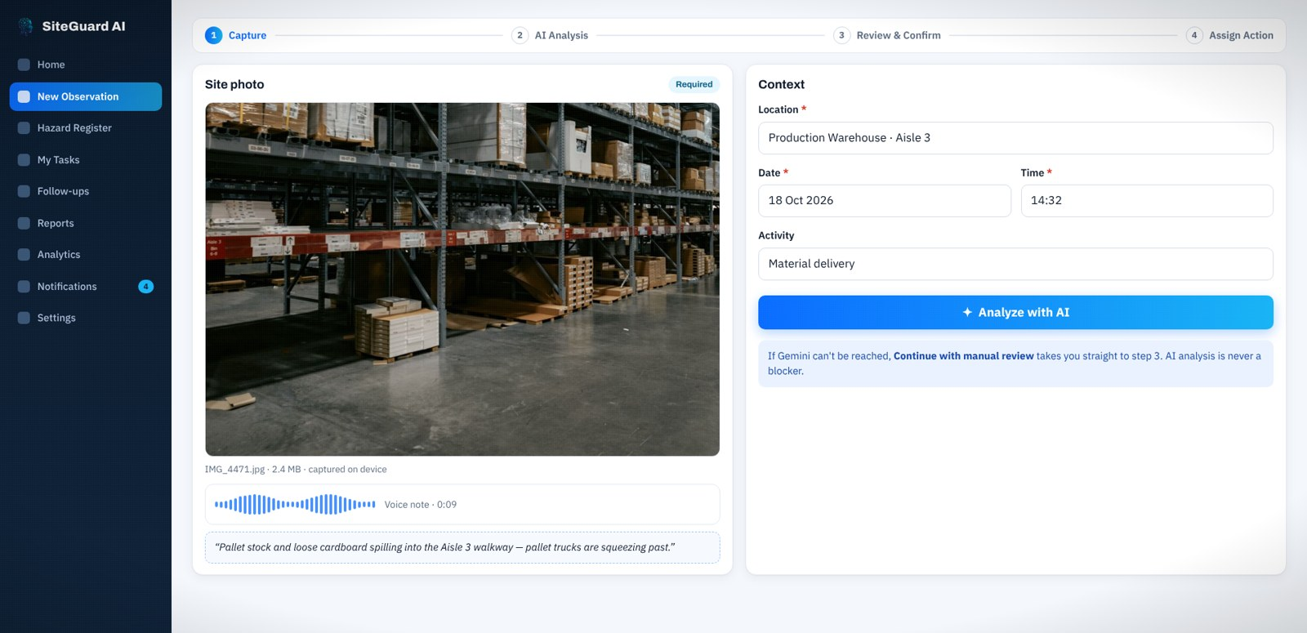
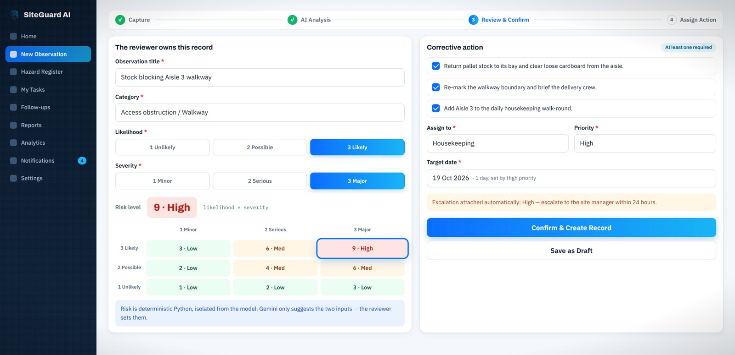
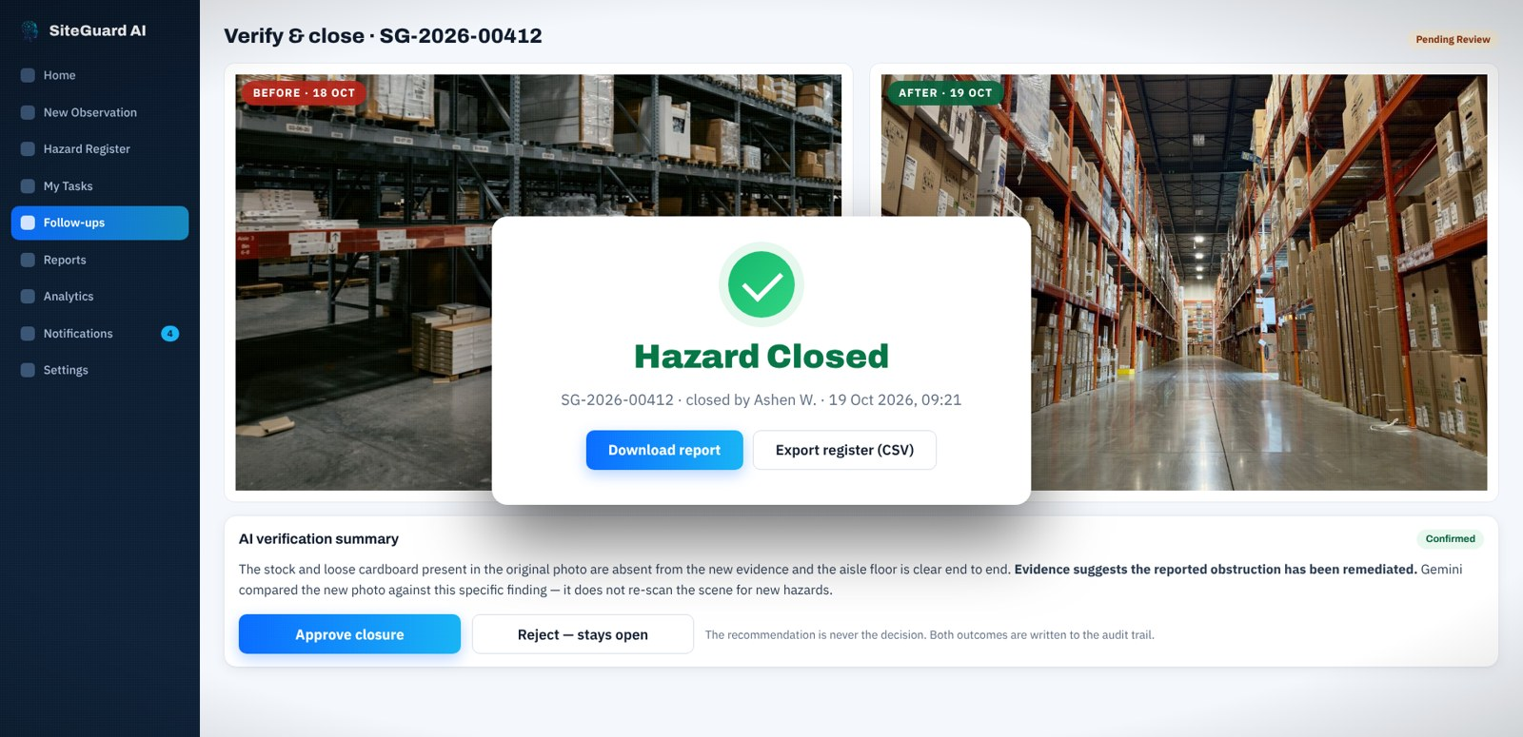
Wireframes / Mock diagrams of the proposed solution
1 · Capture: photo, voice note, context
2 · Review & confirm: risk matrix and actions
3 · Verify & close: before/after evidence
Design principles
✓
Mobile-first capture in under a minute
✓
AI output is always labelled a proposal
✓
Mandatory fields marked and validated
✓
Status colours: Open, In Progress, Closed

Slide 7
Architecture diagram of the proposed solution
Google Cloud Run · Streamlit app (Python)
Gemini 3.5 Flash API
Multimodal analysis · closure comparison · site insights (structured JSON)
Safety reviewer
Phone or laptop browser
UI views Capture · Register · Follow-up · Insights
Workflow rules Every change → audit history
Cloud Firestore
Hazard register + audit history
Site / safety manager
Dashboards & insights
Risk matrix Deterministic likelihood × severity
Insights digest Counts computed in Python
Cloud Storage
Photo & voice-note evidence
Auth Salted PBKDF2 hashes, signed tokens
Cloud Build · gcloud run deploy --source .
google-genai SDK · response_schema

Slide 8
Technologies to be used in the solution
Layer | Technology | Used for
Generative AI | Gemini 3.5 Flash via the google-genai SDK | Multimodal hazard analysis, before/after closure comparison, register-wide Site Insights
AI output control | response_schema + Pydantic models | Schema-enforced JSON: category, confidence, risk inputs, actions
Hosting | Google Cloud Run (container, scales to zero) | Public, serverless deployment of the app
CI / build | Google Cloud Build | One-command deploy from source
Database | Google Cloud Firestore (Native mode) | Hazard register and append-only audit history
Object storage | Google Cloud Storage | Photo and voice-note evidence linked to each finding
Application | Python 3, Streamlit, pandas | UI, workflow rules, deterministic risk matrix, analytics, CSV/HTML reports
Security | Salted PBKDF2-SHA256, signed session tokens, lockout | Every action attributed to a signed-in reviewer

Slide 9
Estimated implementation cost (optional)
How cost scales in production (usage-based)
Prototype today
Gemini API
Per token: 1 call per observation, 1 per follow-up, 1 per Site Insights briefing. Photos are the main input; text output is small.
$0
Cloud Run
Per request-second while the app is serving; zero when idle.
Runs end to end inside Google Cloud free tiers: Cloud Run, Cloud Build, Firestore, Cloud Storage and the Gemini API free tier.
Cloud Run scales to zero, so an idle site costs nothing.
Firestore
Per document read/write; each hazard is one small document plus history entries.
Cloud Storage
Per GB stored; one photo (and optional voice note) per observation or follow-up.
Site estimate = observations per day × these drivers, at published Google Cloud rates.

Slide 10
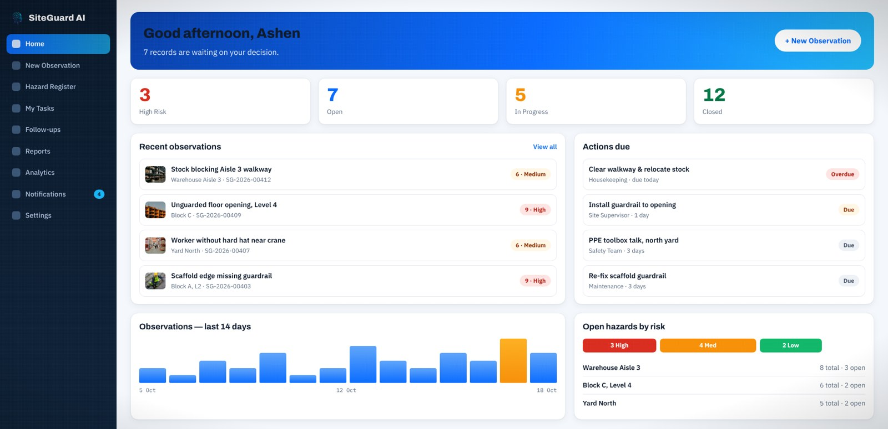
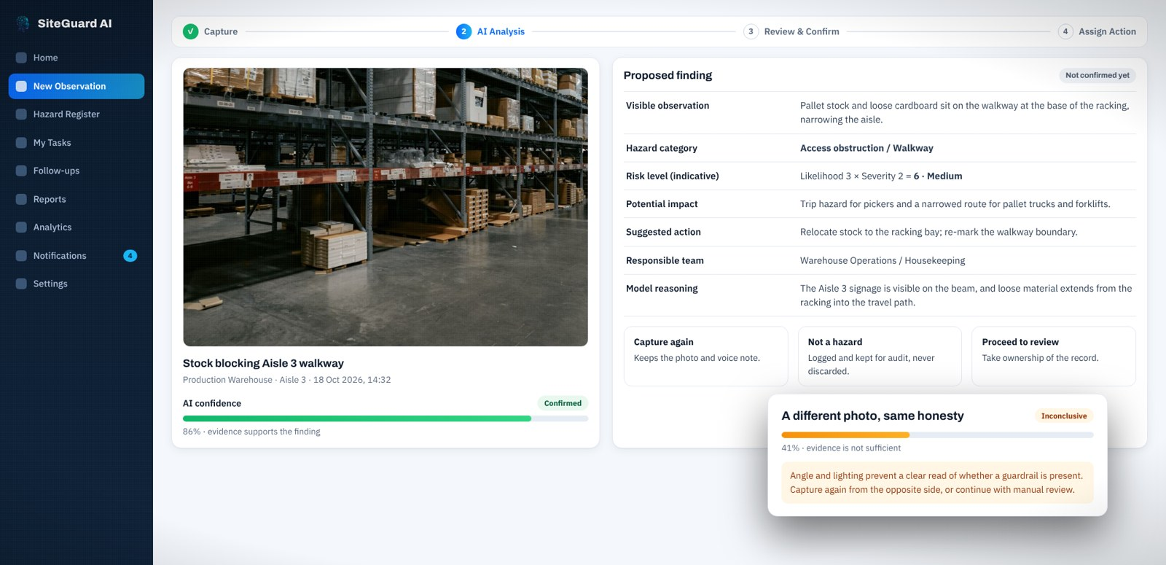
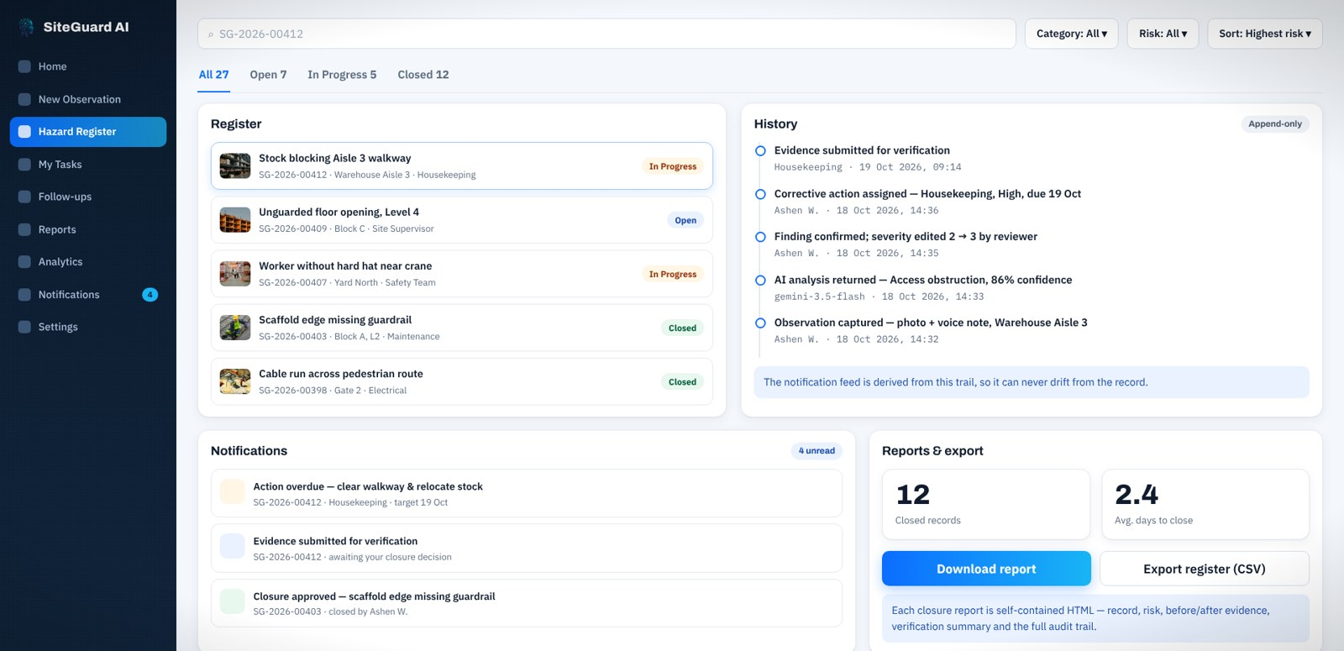
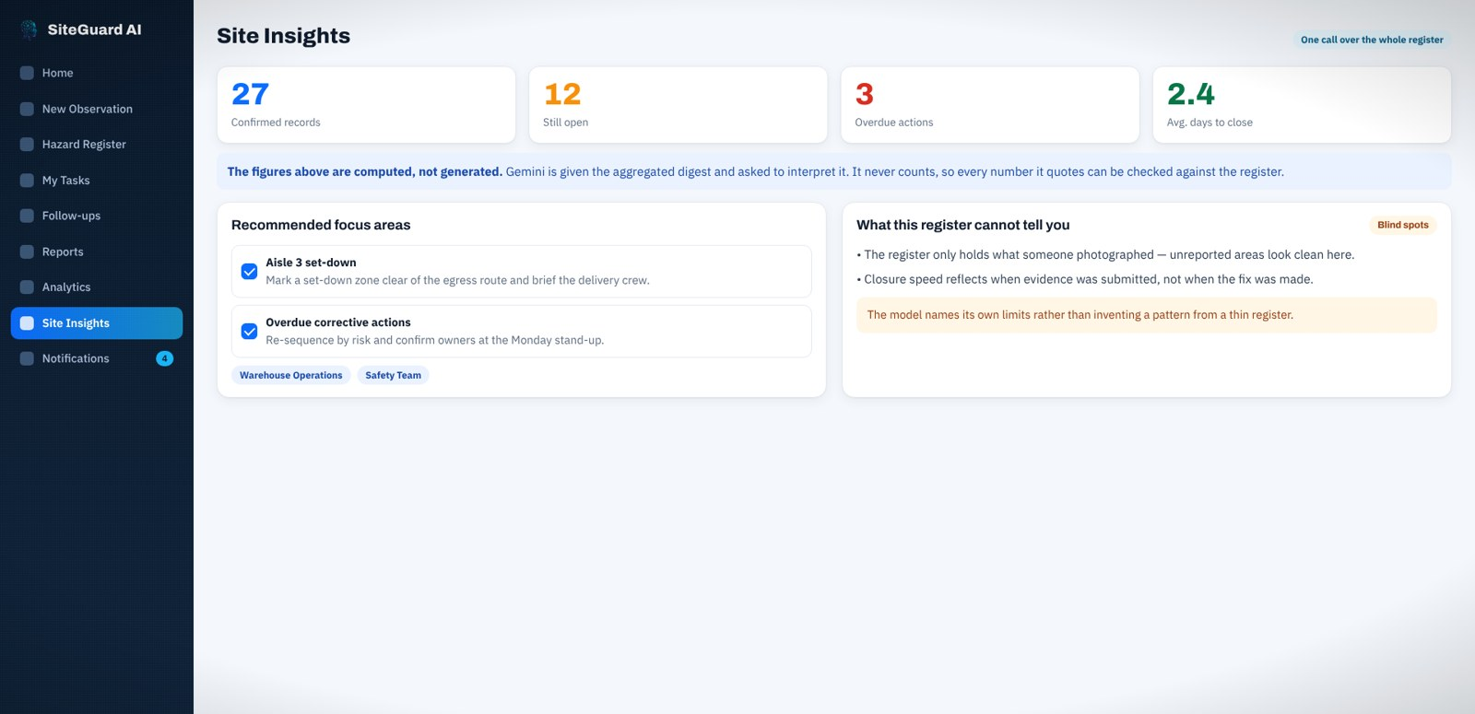
Snapshots of the prototype
Dashboard: counts, recent observations, actions due
Gemini proposal with confidence and an "inconclusive" example
Hazard register with append-only history
Site Insights: computed counts + Gemini briefing

Slide 11
Prototype Performance report / Benchmarking
1
0
4×
100%
Gemini call per observation
(photo + voice + context together)
regex parsing — output is
schema-validated JSON
automatic retries on Gemini 503
(2 s, 5 s, 10 s back-off)
state changes need a human
and are written to the audit trail
Evaluation set
Reliability by design
• 9 real site photos across 3 hazard classes: unprotected edge, obstructed walkway, PPE concern.
• Each class has clear and deliberately ambiguous images, plus "after" photos for closure.
• Expected: clear → correct category; ambiguous → "uncertain"; after → closure supported.
• Risk is deterministic: the same likelihood and severity always give the same score.
• If Gemini is unreachable, "Continue with manual review" keeps the workflow moving.
• Site Insights needs at least 5 confirmed records before it reads patterns, and names its blind spots.
• Offline demo mode with clearly labelled mock AI for unreliable networks.

Slide 12
Additional Details / Future Development
1
More hazard classes
2
Local languages
3
Plant-wide benchmarking
Lockout-tagout, blocked fire exits, spills, machine guarding — each a new prompt and schema value.
Voice notes in Sinhala, Tamil and other languages, using Gemini's multilingual audio understanding.
Compare sites and shifts; trend repeat hazards and time-to-close across a whole operation.
4
Enterprise integration
5
Offline mobile capture
6
Evaluation pipeline
Push corrective actions to CMMS/ERP tools; SSO and signed evidence URLs for production.
Capture on the floor without signal; sync and analyse when the device reconnects.
Track accuracy and calibration on a growing labelled set with every prompt change.

Slide 13
Provide links to your:
GitHub Public Repository: https://github.com/Ashenweerasinghe/siteguard-ai
Demo Video Link (3 Minutes): https://www.youtube.com/watch?v=BarPClAyHYA
Final Product Link: https://siteguard-ai-463547683061.us-central1.run.app/
Demo login for judges
Username: demo Password: Safeguard@123 (Safety Officer role)
Team Ceylon InnovAI · Maniesha Abeysekera (team leader) · Ashen Weerasinghe

Slide 14
Responsible AI by design
1
A human approves every state change
2
No verdicts — only evidence
Confirm, assign and close all need a reviewer's click, attributed by name and time.
Gemini never says "safe", "compliant" or "fixed"; only "evidence suggests" or "inconclusive".
3
Every finding links to its source
4
Computed, not generated
Each record keeps the original photo and voice note, so any finding can be checked.
Risk scores and insight counts come from Python; Gemini interprets, it never counts.

Slide 15


